Slide 1
THE CLOTHES LA ROPA

Slide 2
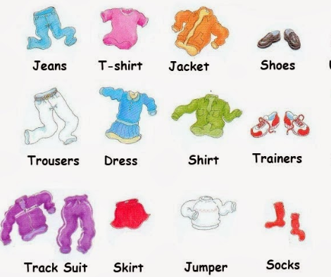
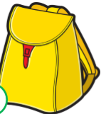
watch
Bag

Slide 3
VOCABULARY
Hat --- sombrero Cap --- gorro Shirt --- camisa
Sweater -- chaleco Jacket --- chaqueta
Skirt --- falda Tracksuit -- buzo Shoes – zapatos
Socks ---calcetines Trousers – pantalones Dress – vestido
Coat –abrigo Gloves – guantes Scarf – bufanda
T-shirt –polera Sandals – Sandalias Shoes –zapatos

Slide 4
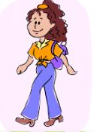
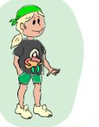
Uso del verbo vestir en inglés. Wearing
She is wearing jeans, a t-shirt, boots and a bag. (Ella viste jeans, una polera, botas y una cartera.)
He is wearing shorts, a t-shirt and trainers.

