Slide 1
THE NATURAL WORLD
https://www.youtube.com/watch?v=CPvqLmt4oNk

Slide 3
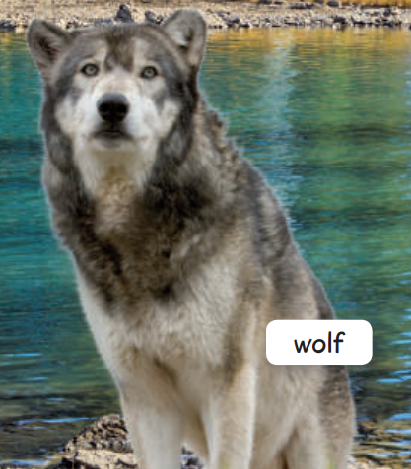
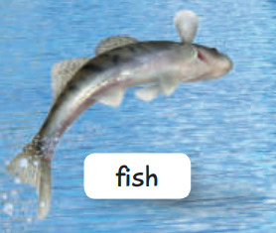
DESCRIBING ANIMALS

Slide 4
