Slide 1
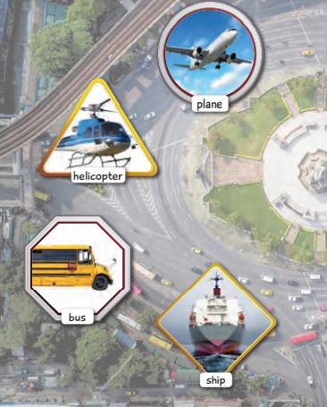
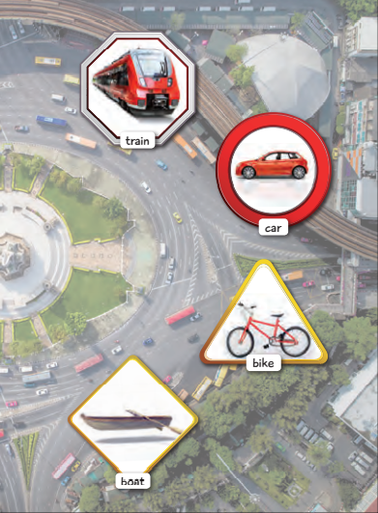
MEANS OF TRANSPORT

Slide 2
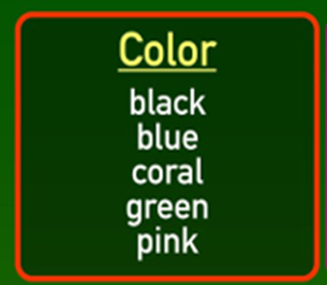
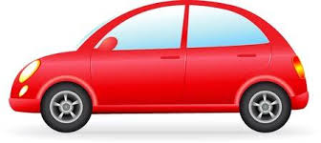
ADJETCTIVES

Slide 3
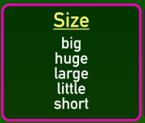
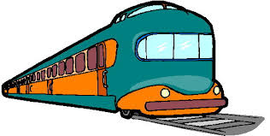
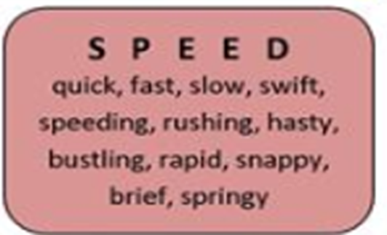

Slide 4
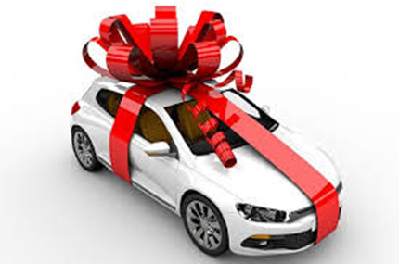
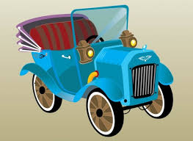
This car is old.
https://www.youtube.com/watch?v=3JZi2oDvPs4
https://www.youtube.com/watch?v=fT2VCpfafrg

Slide 5
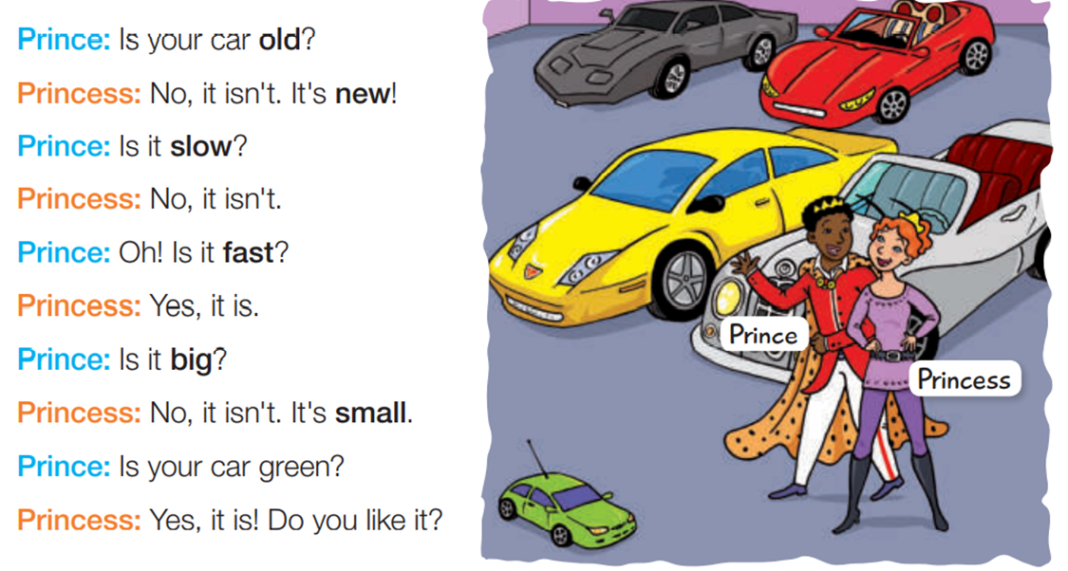
Question: Is it………..? Answers: yes, it is. (affirmative) no, it isn´t. (negative)

