Slide 1
The world of apps
Grade: 8th
Unit1:Information and communication technologies

Slide 2
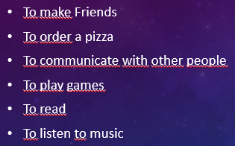
Do you recognize these apps? What do you use it for?

Slide 3
Expressing possession
I ------MINE
YOU ----- YOURS
HE -----HIS
SHE ------HERS
IT ------ITS
WE -----OURS
THEY ----- THEIRS

Slide 4
Possessive pronouns
It is a pronoun that is used to indicate possessions or ownership
This pen is my pen , not your pen This is mine , not yours.

Slide 5
Subject pronouns – possessive pronouns
I have a bicycle
You have a bicycle
He has a bicycle
She has a bicycle
We have a bicycle
They have a bicycle
1- The bicycle is mine
2- The bicycle is yours
3- The bicycle is his
4- The bicycle is hers
5- The bicycle is ours
6- The bicycle is theirs

