Slide 2
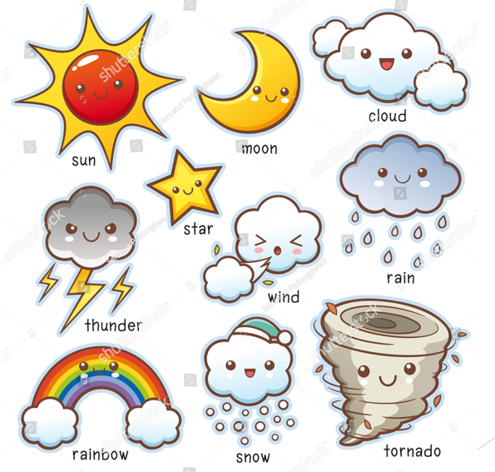

Slide 3
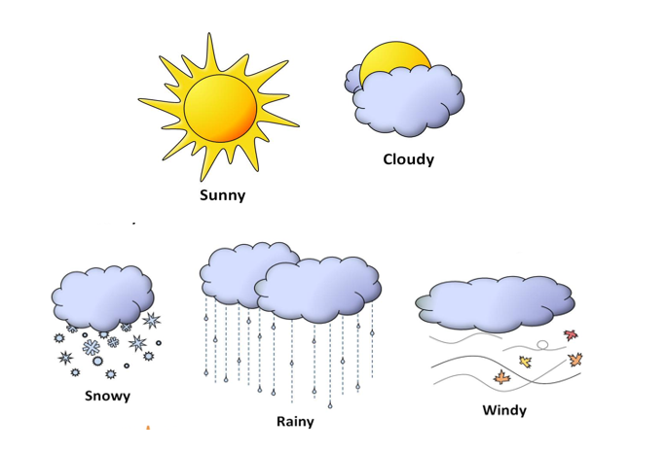
https://www.youtube.com/watch?v=XcW9Ct000yY&t=96s&ab_channel=DreamEnglishKids

