Slide 1
MY FAMILY
hthttps://www.youtube.com/watch?v=FjrxzX-24KEtps://www.youtube.com/watch?v=u9kpdmCtO34

Slide 2
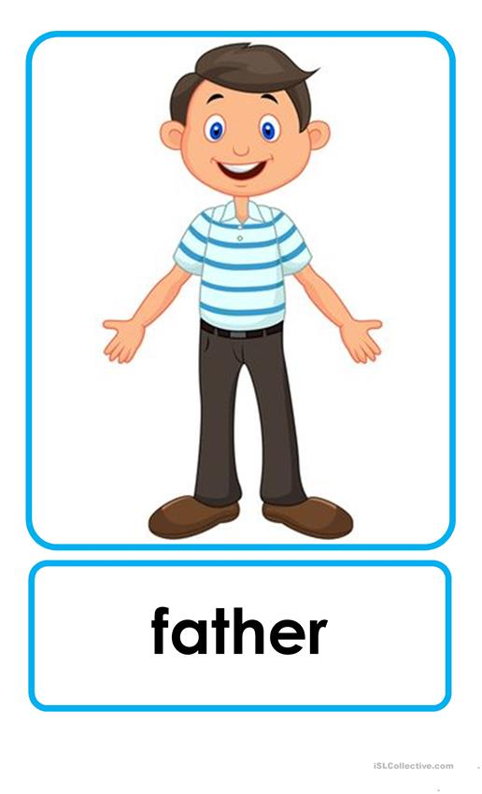
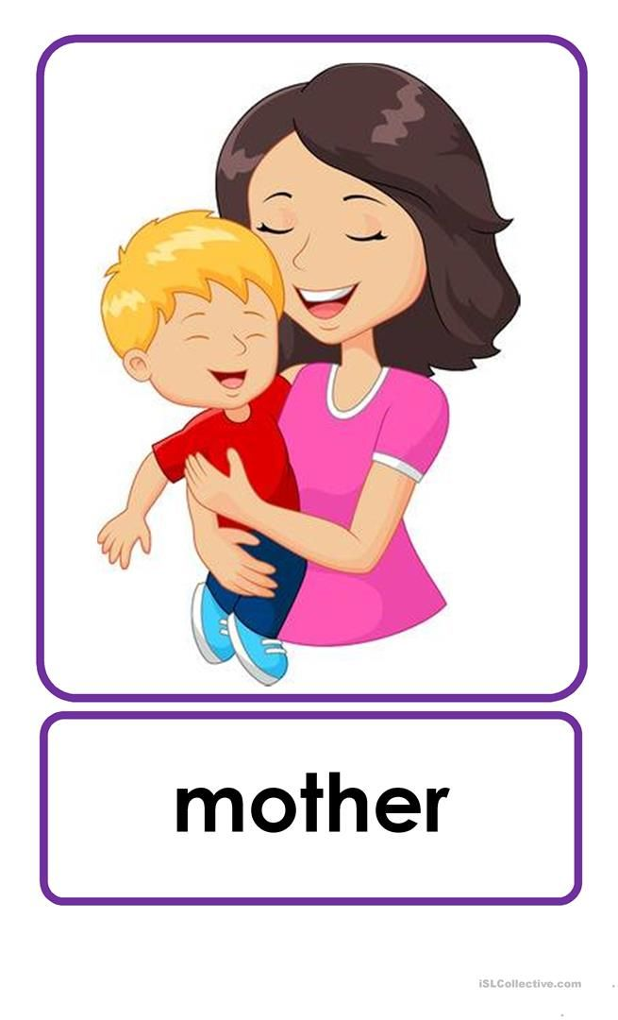
DAD MUM
DADDY MOMMY

Slide 3
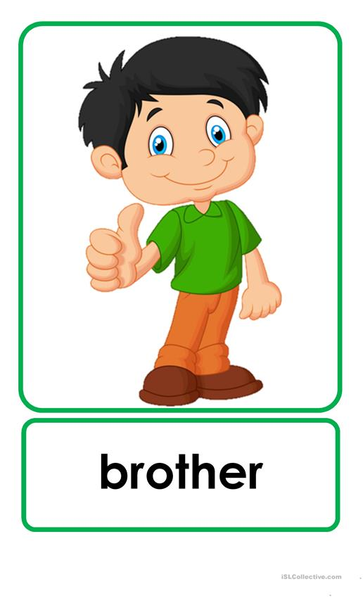
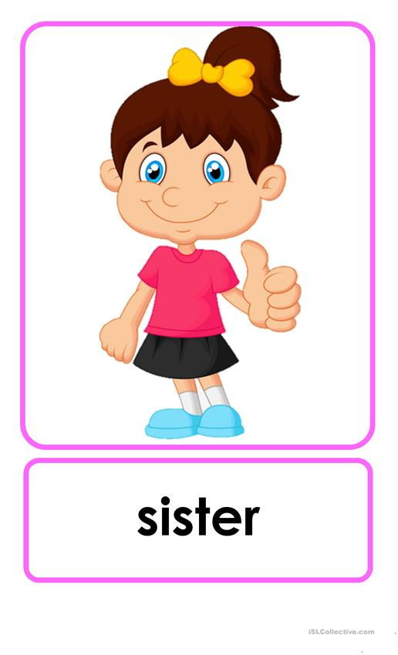

Slide 4
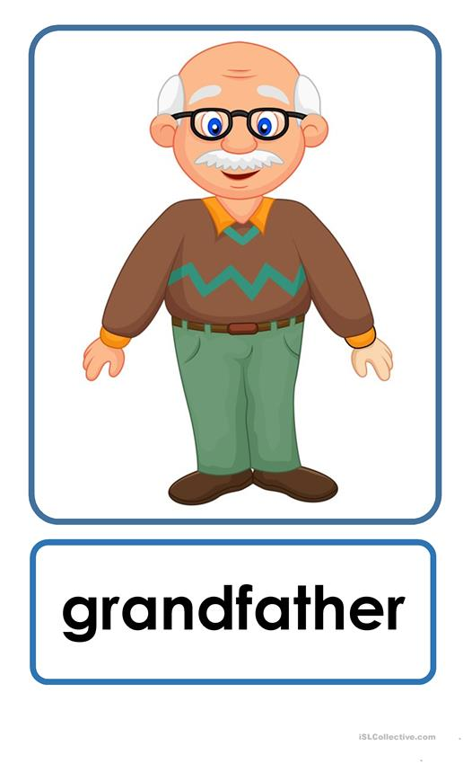
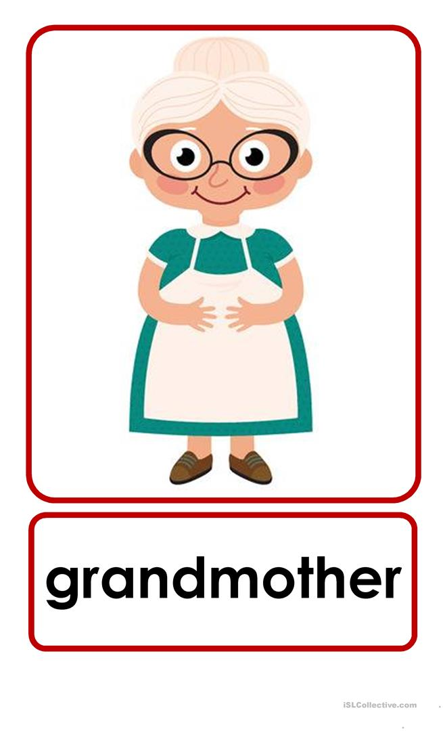
GRANDPA GRANDMA
GRANDAD GRANNY

