Slide 1
THIS IS MY FAMILY
https://www.youtube.com/watch?v=JnuPPhmKre8

Slide 3
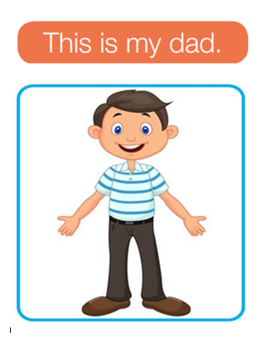

Slide 5
