Slide 1
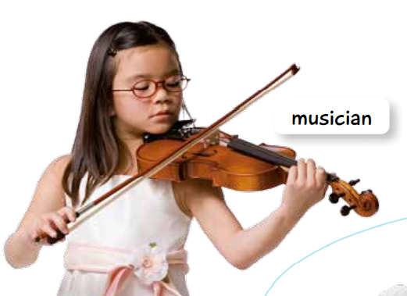

Slide 3
https://www.youtube.com/watch?v=3jtfUyAcFBU

