Slide 1
THE NATURAL WORLD
https://www.youtube.com/watch?v=LJtUy6-Aaio

Slide 2
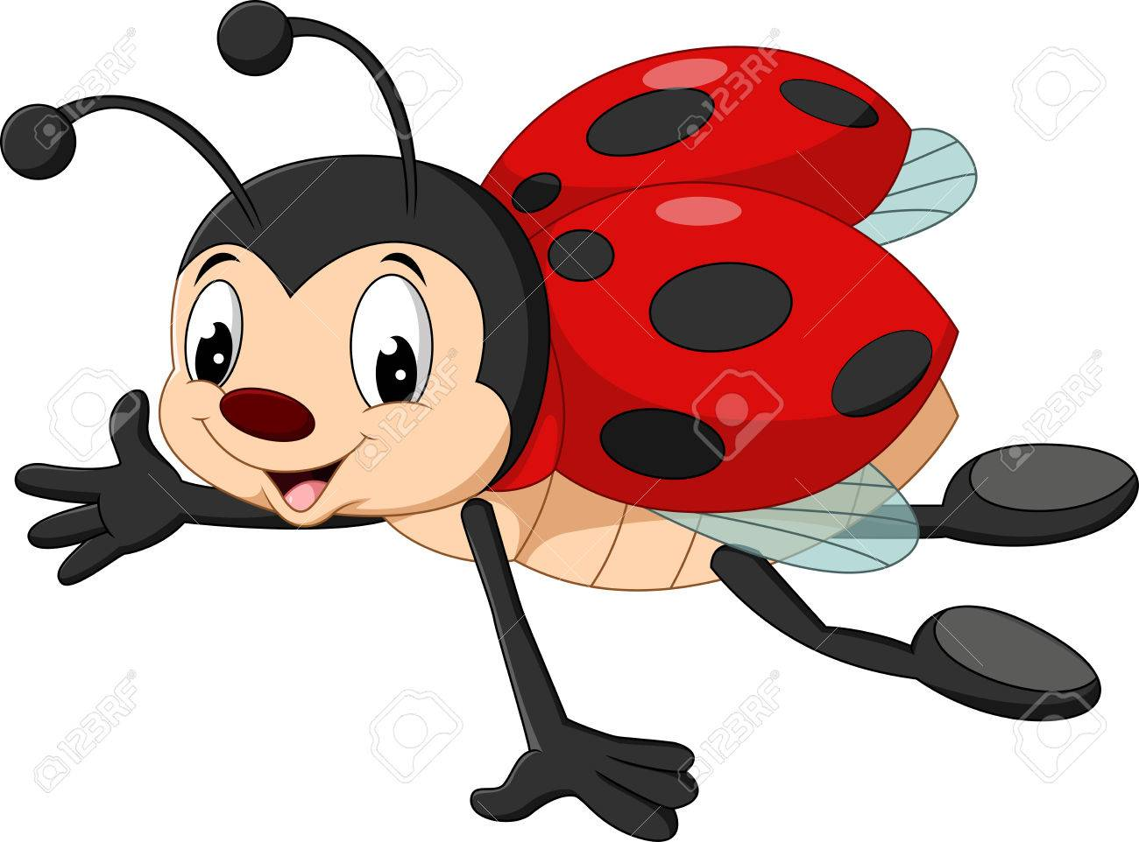

Slide 3
