Slide 1
Unit 2: Around Town
Grade: 6th
Miss Pamela Knuckey

Slide 2
Today we’ll see about reading comprehension

Slide 3
Never forget
Pay attention with the relevant information
Underline dates, names, places,etc
Pay attention with the questions after the text

Slide 4
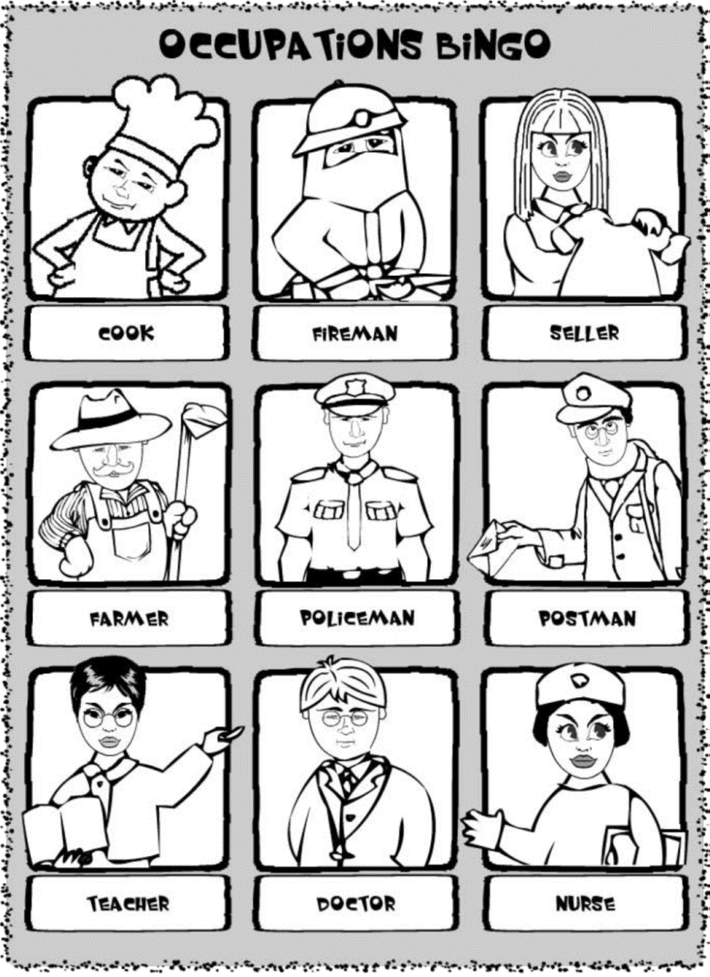
About professions and occupations
The text is about Fabiola, she tells you about her father and what he does. He dedicates his life helping people but change the profession.
Remember the vocabulary of the unit and read carefully every word.

