Slide 1
Unit2: Healthy Habits
Grade: 7th
Miss Pamela Knuckey

Slide 2
About last class , what if we make a feedback?
Qué vimos la clase anterior?
Recuerdas palabras del vocabulario visto en la clase anterior?
Podrías darme un ejemplo?
Que son las rutinas diarias?

Slide 3
Today we’ll see healthy food
Do you think is important eat healthy?

Slide 4
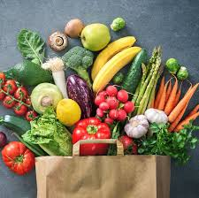
Fruits, vegetables, drinks
Apple: manzana
Pineapple: piña
Banana: plátano
Grapes: uvas
Strawberry: frutilla
Blackberry: mora
Blueberry: arandano
cherries: guindas
Orange: naranja
Zanahoria: carrot
Lechuga: lettuce
Tomate: tomato
Pepino: cucumber
Limón: lemon
Brocoli: broccoli
Cebolla: onion
Champiñones: mushrooms

Slide 5
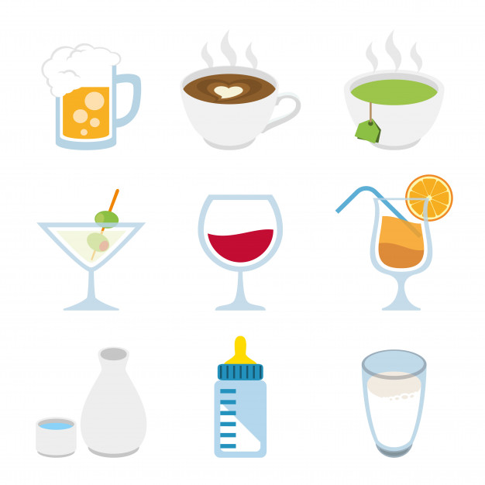
drinks
Agua: water
Soda: bebida
Tea: te
Coffee: café
Vino: wine
Juice: jugo
Leche:milk

