Slide 1
UNIT3: SPORT AND FREE TIME ACTIVITIES
Grade: 7th
Miss Pamela Knuckey

Slide 2
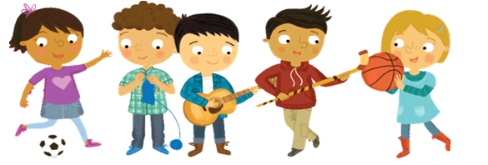
OBJECTIVE
Aplicar vocabulario de deporte y expresiones usando I like.

Slide 3
Some typical objects
gloves : guantes
skates : patines
bat : bate
ball : bola
helmet : casco
goggles : lentes de agua
net : malla
racket : raqueta
sneakers : zapatillas
Stick: palo

Slide 4
Choose a sport

Slide 5
I like …..

