Slide 1
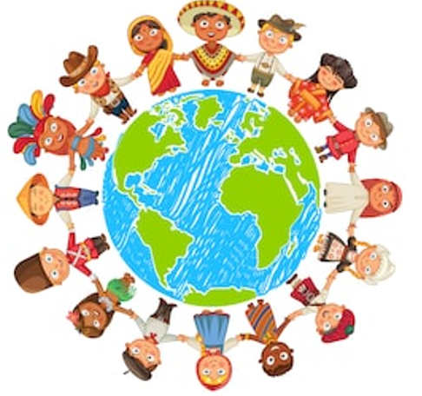
Unit2: Countries, cultures and customes
Grade: 8th
Miss Pamela Knuckey

Slide 2
Do you know the seven wonders?
Modern world

Slide 3
Taj mahal – India

Slide 4
Christ redeemer- Brazil

Slide 5
Chichén Itzá- Mexico

Slide 6
great wall of china- China

Slide 7
Roman Coliseum - Italy

Slide 8
Machu Picchu- Peru

Slide 9
Petra- Jordania

