Slide 1
Unit2: cultures,countries and customs
Grade :8 th
Miss Pamela Knuckey

Slide 2
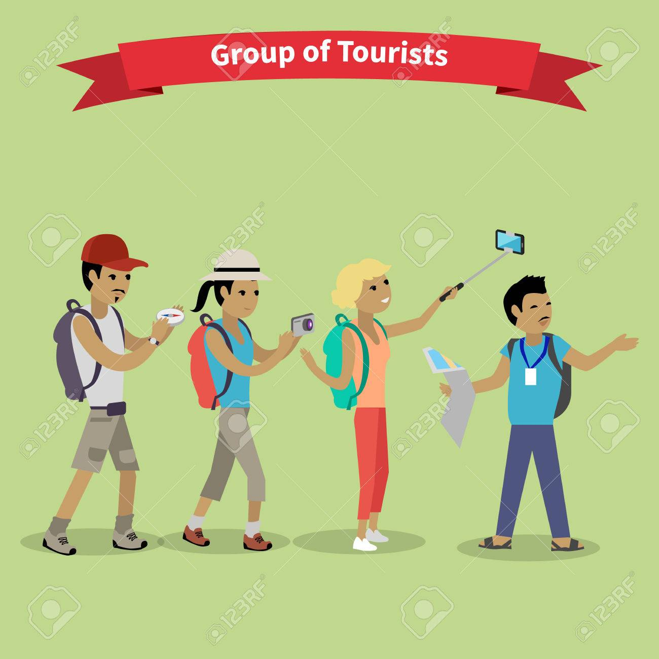
Today class
Imagine you are a tour guide and people wants to know about the place they are visiting

Slide 3
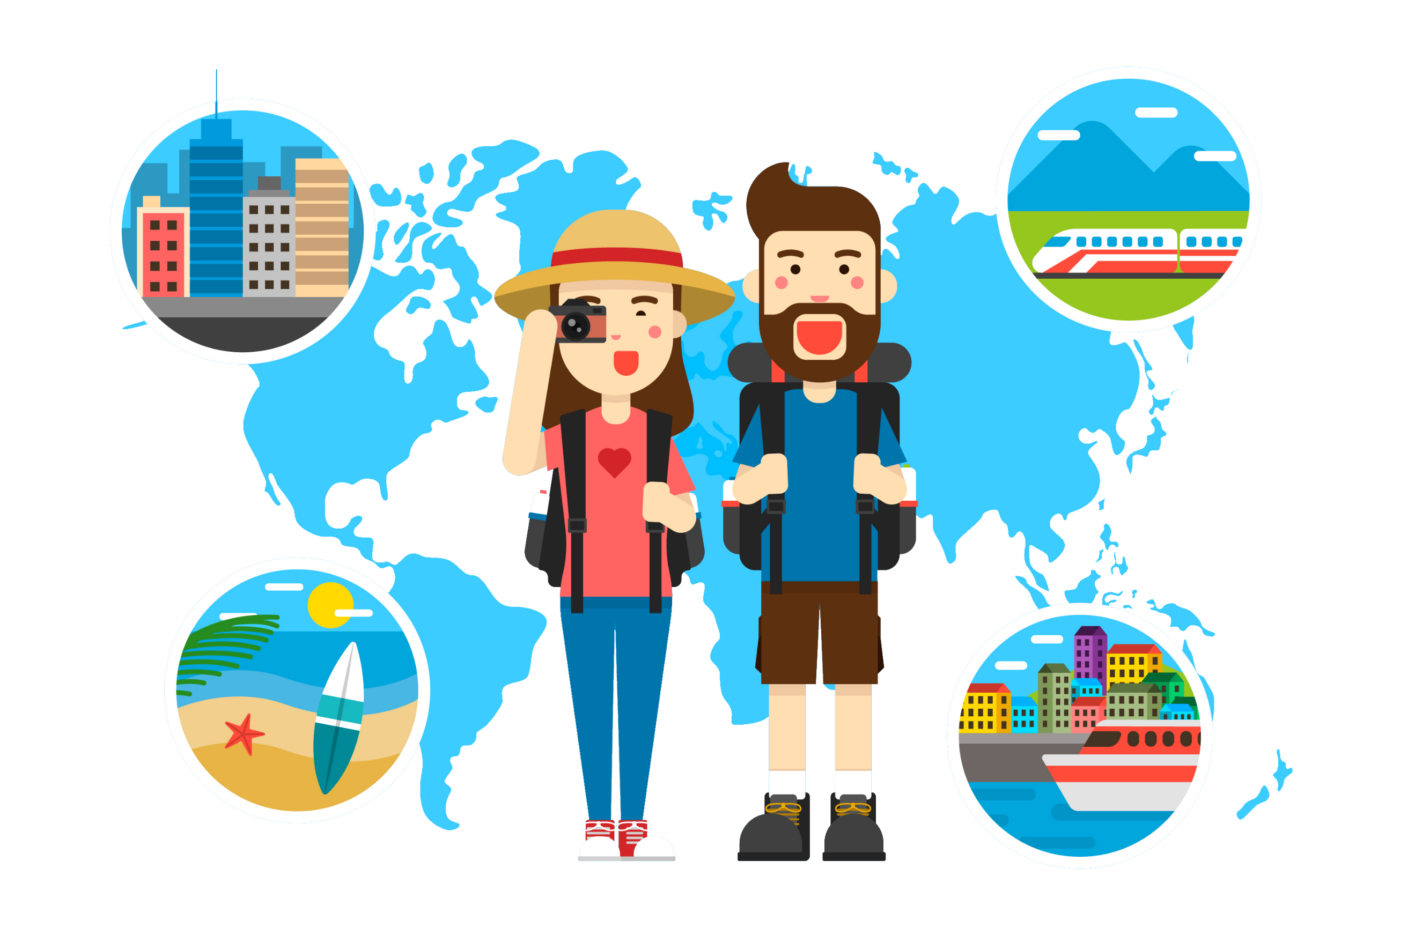
Qué información relevante entregarías?
Dates (fechas)
Names (nombres)
Measurements ,numbers( medidas,números )
Anecdotes (anécdotas )
Stories and history about the place( historias e historia acerca del lugar)
Additional information ( Datos adicionales )

Slide 4
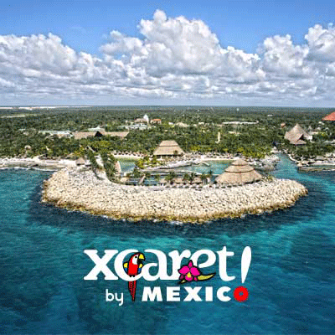
Let’s show you xcaret
Xcaret is a water, theme, amusement, eco-archaeological park and more, in one place. Due to its privileged location in the Mayan jungle among underground rivers, cenotes and facing the Caribbean Sea, Xcaret has impressive scenarios where you can do different activities and enjoy to the fullest those scenarios.
located on the Caribbean coastline of the Yucatán Peninsula, in the state of Quintana Roo, Mexico
The site was occupied by the pre-Columbian Maya and functioned as a port for navigation and an important Maya trading center.

