Slide 1
UNIT2: COUNTRIES,CULTURES AND CUSTOMES
GRADE:8TH
MISS PAMELA KNUCKEY

Slide 2
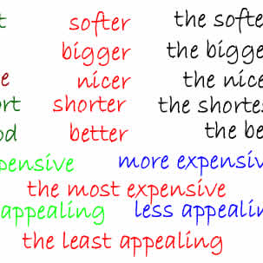
ABOUT LAST CLASS…
Do you remember why do we use “er”?
What is a comparative sentence?
What is an adjective?
What do you compare in a sentence?

Slide 3
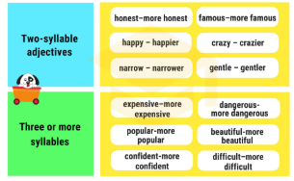
Today we´ll see… adjective with two syllables and more
OBJ: Aplicar estructura gramatical en oraciones comparativas

Slide 4
Grammar structure
English class is more interesting than History class
NOUN + MORE + ADJECTIVE WITH 3 SYLLABLES + THAN + NOUN

