Slide 1
UNIT3: GOING PLACES
GRADE: 8TH
MISS PAMELA KNUCKEY

Slide 2
OBJ
Aplicar vocabulario de lugares de la ciudad.

Slide 3
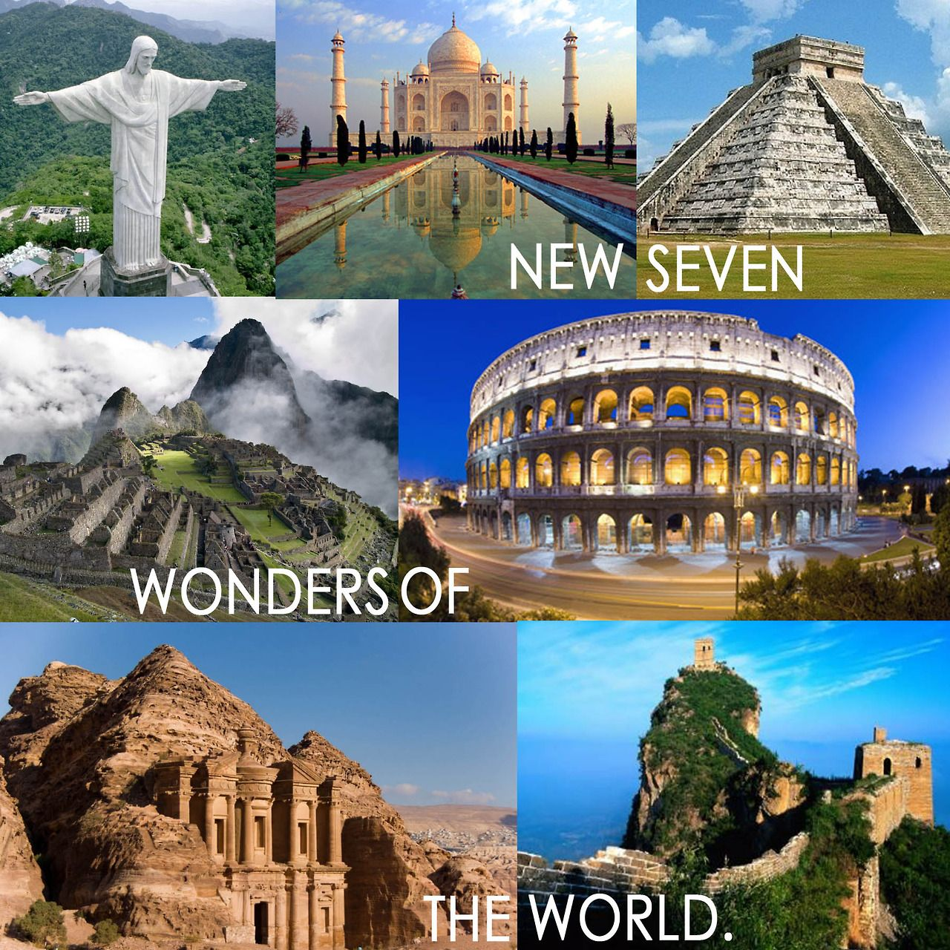
THE SEVEN WONDERS
Las siete maravillas del mundo modern.

Slide 4
How many countries do you know?

