Slide 1
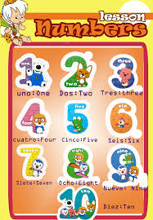
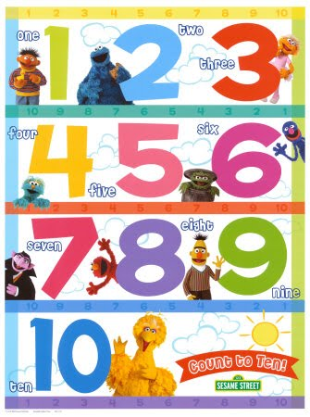
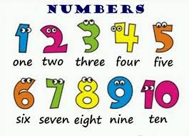
NUMBERS
https://www.youtube.com/watch?v=HCGHcf1z6YI
https://www.youtube.com/watch?v=NzIqcYNP5kY

Slide 4
